Slide 1

Towards effective grantmanship among researchers
How do I write a Convincing and Winning Proposal?
A few tips, ideas and suggestions for reflection
JPR Ochieng’-Odero PhD, HSC
Team Leader, EARF
September 15th, 2016

Slide 2
What is the EARF experience telling us?
● Eastern Africa research suppliers ( which is mainly composed of University PIs) are badly out-competed by bidders from elsewhere
Case in point: Non of the 11 calls we made since 2015 have been won by regional suppliers including Kenyan researchers!
● Reason? Poorly conceived, designed and written proposals, poor teaming and poor evidence of proven track record.
Common Shortcomings found Application Bids to the East Africa Research Fund (EARF)

Slide 3
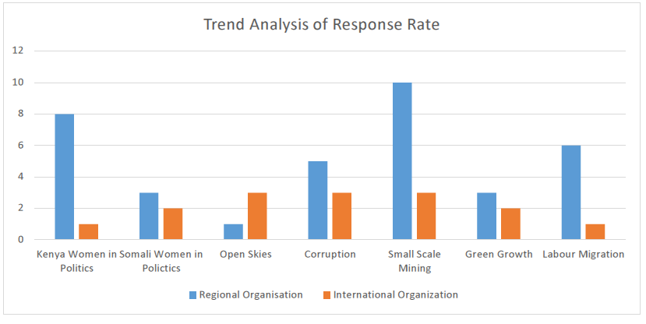
Regional vs International response to EARF calls

Slide 4
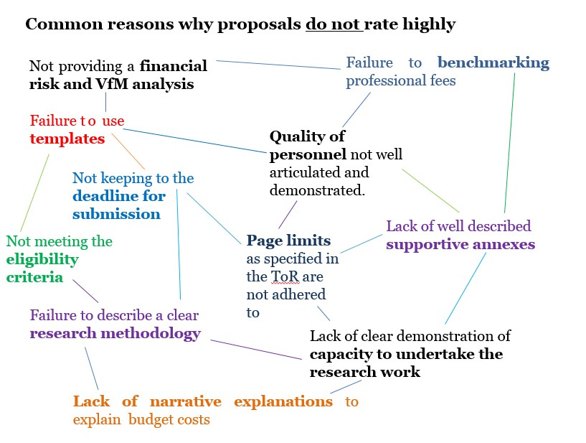
Common proposal shortcomings

Slide 5

Lessons from CNHR are no different
Very few young researchers can write a convincing proposal
Performance of the CNHR DRePHA Call
● Total Applications received:73
● Applications from Public Universities:42
● Applications from Private Universities:7
● Applications from women researchers:25
● Shortlisted applications: 36
● MUC Shortlisted applications:2
● Applications recommended for funding:19
● MUC Applications recommended:0

Slide 6
Agony of the Kenyan researcher
Why is it that so many good idea proposals not get funded?
1) Failure to follow submission guidelines
    2) Lack of buying into why the call has been made
    3) Writing style
__________________________________________________________________________________________
● Low scores
● Lack of funding
5

Slide 7
Anatomy of a well designed proposal
8 Elements:
● Summary: What is this proposal all about?
● Background: Why should this project be done?
● Objectives: What do you hope to achieve?
● Activities: What will you plan to do?
● Work plan: How will you logically plan to achieve your objectives?
● Outputs & Impact: Who will be better off at the end of the project and why?
● Evaluation: How can you test if the project is working?
● Budget: How much will it cost?
6

Slide 8
Write to persuade = Writing with passion
4 Ways to allow the love of your subject
and urgency of the problem come out in your writing
Use Strong, emotive words
Use short, sharp sentences to push your message
Look for an arresting phrase or comparison
Be as brief as possible
7

Slide 9
Two (2) essentials in writing to persuade
● Write to appeal to the Self-Interest of Your Reader
● Find out as much as you can about your funder before you write
● Write with Passion
  ● Let the interest of you subject glow and flow
  ● Write with your heart
8

Slide 10
Tips on how NOT to write a summary
Don’t commit suicide in the summary:
● The summary page is the most important part of your proposal. It is the door to your proposal. Keep it wide open
● Tell the reviewer what the research proposal is about. Don’t fudge or hedge about. Be straight to the point.
The research objective of this proposal is…
● Avoid words that to reviewers do not mean research:
“develop” “design” “optimize” “control”
● No grammatical or spelling mistakes
● Stick to the word count guide
9

Slide 11
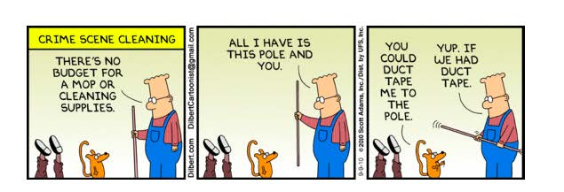
Planning the resources for the project
All projects will need a budget
13

Slide 12
Resourcing the Project (1)
Designing the budget
● Nearly all grants stipulate a budget limit
● By calculating costs you can determine how to achieve the study goals cost-effectively and within allocated limit
● Helps to identify resources available locally and which additional resources may be needed
● Encourages thinking about aspects of the study that may have been overlooked
14

Slide 13
Resourcing the Project (2)
Designing the budget:
● Check grant for budget instructions and template to follow
● Consider costs early on
  Since cost is limiting factor, keep it mind during writing of the proposal, include a resource column in the work plan
● Once ready to start on budget development, use the work plan as guidance
● Identify the resources required for stated activity, the unit cost, and the total cost
● Find ways to be resourceful: community volunteers, interns, a portion of existing staff time rather than a 100% of new person, site-based trainings over hotel-based trainings
15

Slide 14
Resourcing the Project (3)
Designing the budget
● Work with finance to ensure calculations and format are completed well
● Use appropriate currency (US $/Euro etc.)
● For salaries, calculate based on annual rates
● Benefits should be proportional to % effort
● Personnel % effort should not to exceed 100% across grants
● Line items should be detailed, but not too detailed
  i.e. Office supplies or printing 1000 copies are okay as a line item, but
  paper clips, paper reams, …too detailed
● Base on unit cost/cost per item, then determine frequency, and requirements
● Be realistic
● Factor in indirect costs or overheads based on the donor’s preference
16

Slide 15



East Africa Research Fund
What is the EARF?
The EARF is a funding facility managed by PwC on behalf of DFID’s East Africa Research Hub (EARH).
Through this facility, DFID’s country offices in eastern Africa (Kenya, Tanzania, Uganda, Rwanda, Ethiopia, Somalia, Sudan and South Sudan) are supported to use evidence in order to drive development impact and value for money, linking with UK’s wider science and research agenda in the region.
The projects that EARF handles are categorized under two funding windows, namely:
  The Regional Research Programme
  The East Africa Country Research Programme

Slide 16
Current Call
http://www.earesearchfund.org
Topic: Regional Analysis of Youth Demographics
Launch Date: Friday, September 2, 2016
Closing: Friday, October 7, 2016
Proposed Budget: Open
Duration: 12 Months
The objective of this study is to understand the implications of the present and future changes in demographics on social services, labour force and urban planning for four countries in East Africa (Tanzania, Kenya, Rwanda and Uganda); and identify opportunities for policy makers and development partners to maximise the benefits for youth and support sustained inclusive economic growth and poverty reduction.

Slide 17
Current Call (2)
Resources on the EARF website
● Letter of Invitation
● Terms of Reference for the research study
● Instructions to suppliers
● Template for the Summary of the research methodology
● Scoring Methodology
● Checklist

Slide 18
Current Call (3)
Structure of the proposals:
● Component 1: Technical Proposal
  Executive Summary
  Technical bid
  Research methodology
● Component 2: Commercial Proposal
  Commercial bid in a prescribed template
● Component 3: Additional Documentation
  Suppliers Checklist
  Supportive documentation (upon request)

Slide 19
Evaluation Process
A three tier process:
● Compliance check
● Technical Evaluation
  80% of the score
● Commercial Evaluation
  20% of the score

Slide 20
4 Elements of Monitoring & Evaluation
Purpose of M&E is to track and document the contributions of the funded project activities towards achievement of the ultimate goal
Outcomes: Performance or behavior changes over period of time
Outcomes must be SMART – Specific, Measurable, Achievable, Relevant and Time-bound
Outputs: Direct results of project interventions
Outputs must also be SMART
Indicators: Variables for measuring if change has happened
Means of verification: Data sources and tools to be used
11

Slide 21
EARF M&E tool
Regular narrative & financial progress report
Summary of Progress highlights the achievements of the project over the reporting period
List the project outputs that the project has made during the last quarter
Are there specific lessons learnt that you have experienced during this last quarter?
Describe any changes in project management that have occurred during the last quarter
Highlight any limitations or challenges experienced in carrying out the project during the last quarter
Describe any interaction you have had with policy makers and other stakeholders?
Provide details of research/ policy/dissemination events that have been either hosted by the project, or where the project has been invited to make presentations to
Provide a Financial Report for the period

Slide 22
Seek for assistance
Two Resources:
Bourne P. E. and Chalupa L. M. (2006): Ten Simple Rules for Getting Grants. PLoS Computational Biology 2006 Vol. 2 0059-0060
Burroughs Wellcome Fund (2009): Excellence Everywhere. A Resource for Scientists Launching Research Careers in Emerging Science Centers. www.excelenceeverywhere.org
You will only have yourself to blame if you don’t!

Slide 23
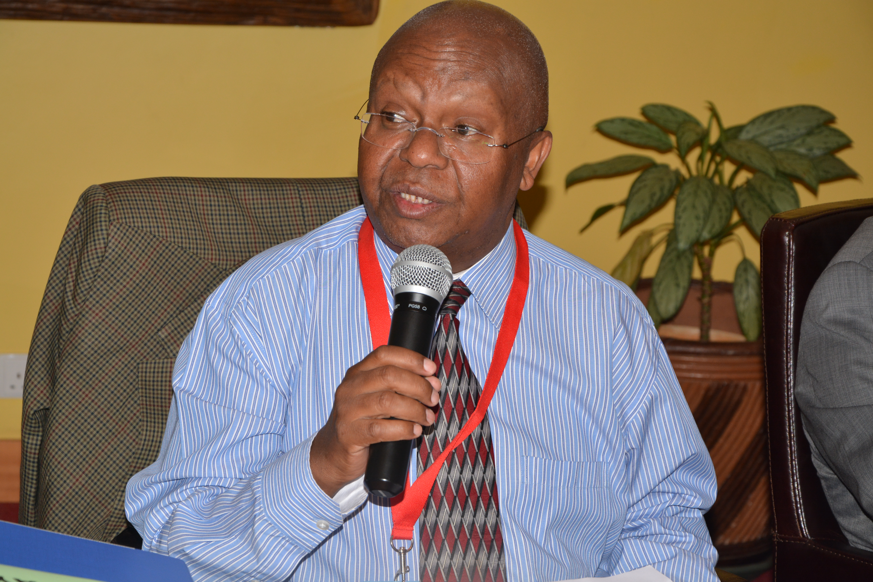
What do we need to do?
The Chartered Machakos University must invest in research training:
● Ensure that research training is more effective
● Make the graduate output is able to compete in the global market place
●Build skills in other areas beyond the focal discipline
Turn supervisors to be `mentors’ for research career development
    ● Involve fellows in writing of papers and grants
    ● Provide career opportunities for fellows
    ● Give pastoral care and moral support
Introduce & nurture research-rich career pathway in the University

Slide 24
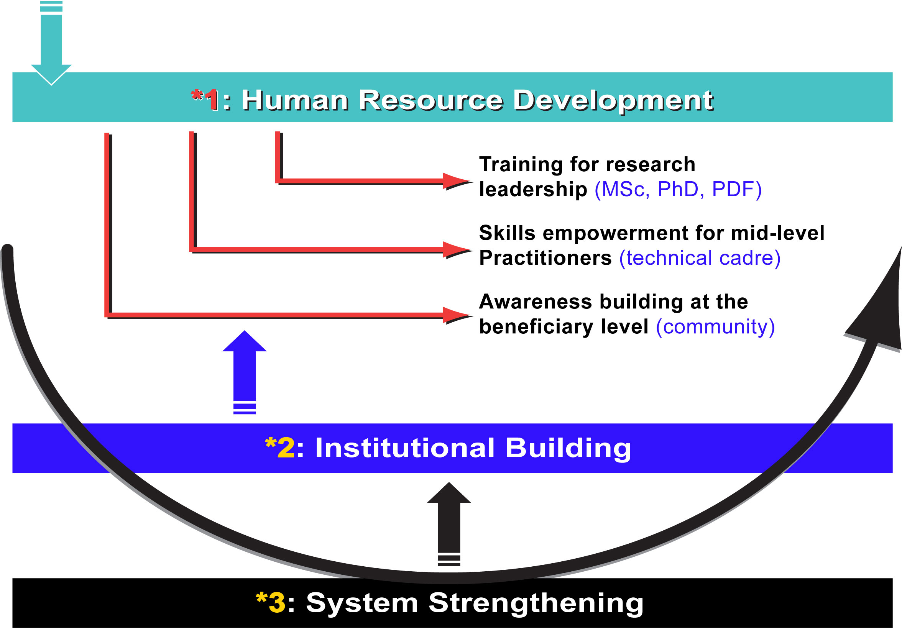
What we must do
Address the 3 levels of capacity engagement

Slide 25

18
Shukran and Good Luck!

