Slide 1


Chandaria Business Innovation and Incubation Centre
Dr. George Kosimbei,
Director, Chandaria Business Innovation and Incubation Centre, Kenyatta University

Slide 2

Innovation
Is the application of new solutions that meet new requirements, inarticulate needs, or existing market needs.
Entails investments aimed at producing new knowledge
A driver of economic growth and structural change
In itself, innovation is not an objective. It needs to be placed in the broader context of its contribution to aggregate economic performance

Slide 3
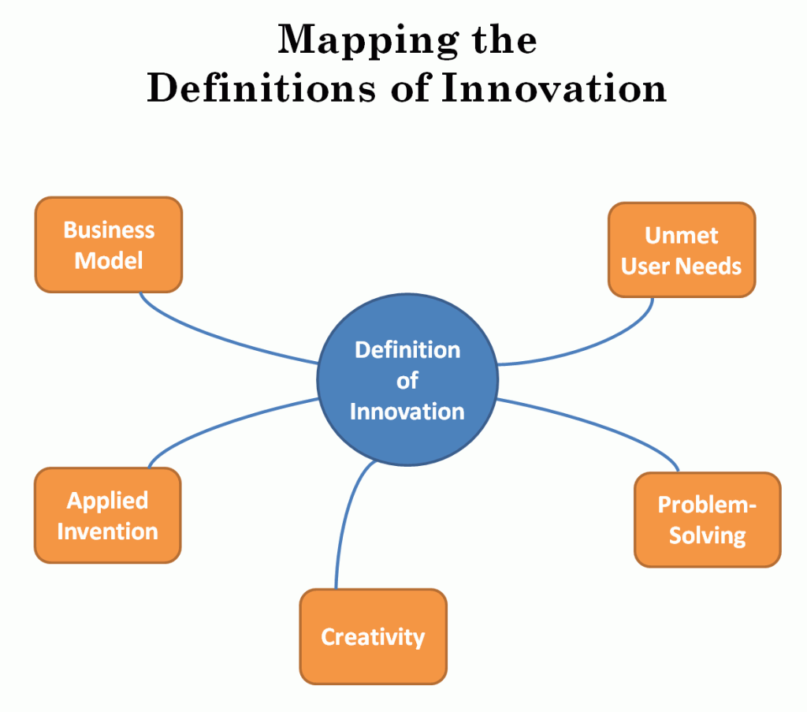

Slide 4
Enterprise Pyramid
Revenue
Business plan
(Product is refined)
Idea
(search/customer/ pivot)
Scale
Profit

Slide 5
Evaluation of Ideas
Ideas are evaluated by a team of reviewers comprising of technical mentors and other experts
They are scored individually and later discussed in a panel comprising of secretariat staff to ensure only quality ideas are incubated

Slide 6
Evaluation Model
Demand for the product (or Push or Pull demand)
Project skills (execution and development)
Control
Capital
Others- Marketing, security, etc

Slide 7
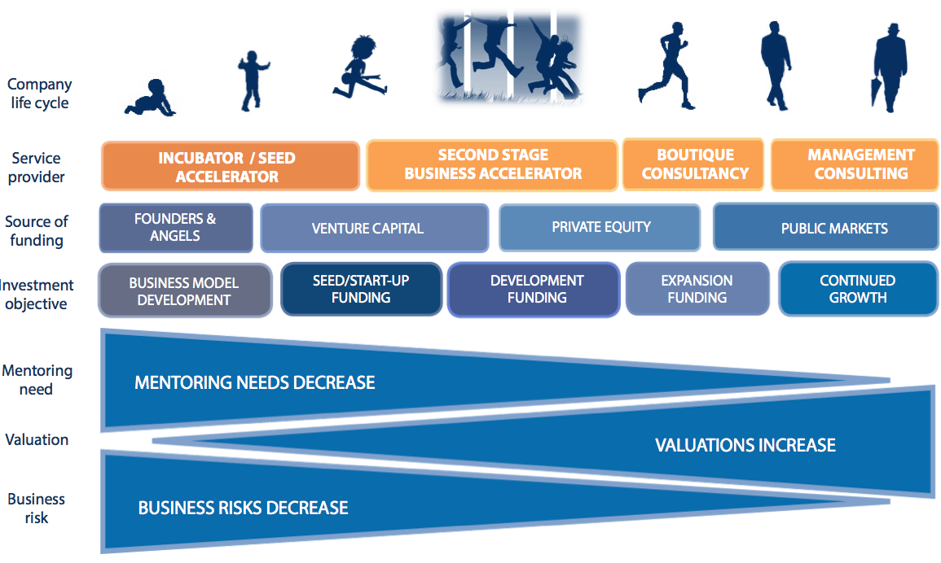
Incubation Process

Slide 8
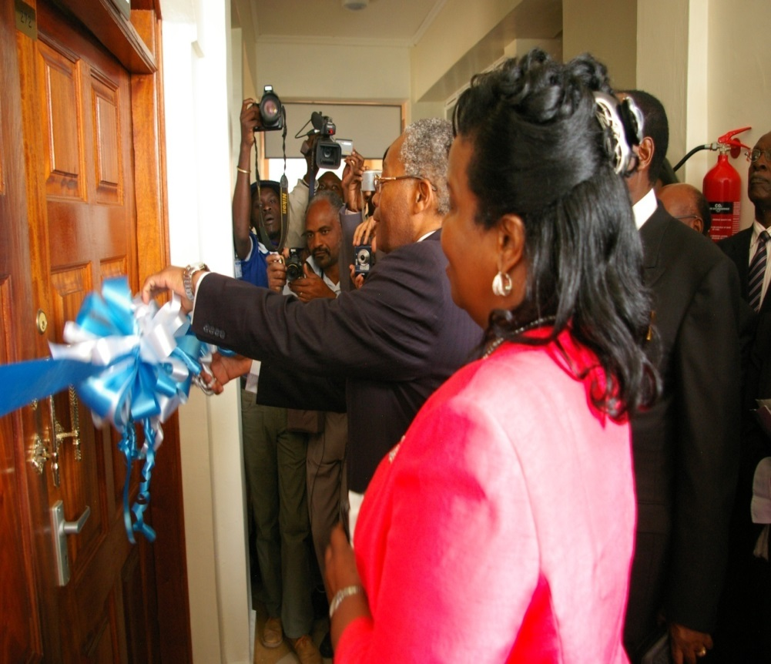
History of Chandaria BIIC
Kenyatta University established Chandaria Business Innovation and Incubation Centre (Chandaria BIIC) in July 2011
This was to encourage and support Kenyans to develop innovative ideas into viable businesses
Kenyatta University’s VC and Chief Guest, Official opening, July 2011

Slide 9
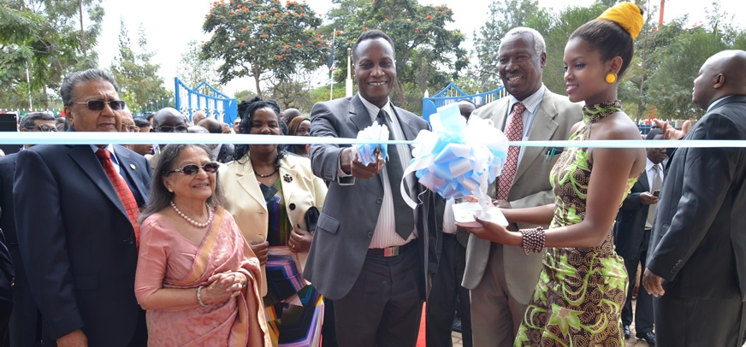
History of Chandaria BIIC
Official opening of Chandaria BIIC Building by Cabinet Secretary for Education, Prof. Jacob Kaimenyi and Dr. Manu Chandaria, July 2013

Slide 10
Access to Chandaria BIIC
Its open to all Kenyans
70% KU students, staff and 30% non- KU Kenyans

Slide 11
Entry Levels
Idea phase
Research and Development
Prototype phase
Start-up
Market phase
Scaling- up phase
Other (Specify)

Slide 12
Services at Chandaria BIIC
Assistance with business basics
Networking activities
Marketing assistance
High-speed Internet access
Help with accounting/financial management
Access to seed capital, bank loans, loan funds and guarantee programs
Help with presentation/ pitching skills
Links to higher education resources
Links to strategic partners
Access to angel investors or venture capital
Comprehensive business training programs
Advisory boards and mentors
Management team identification
Help with business etiquette
Technology commercialization assistance
Assistance with regulatory compliance
Intellectual property management

Slide 13
Services at Chandaria BIIC
Virtual incubation is used to increase access to incubation services to Kenyans irrespective of their geographical location.
This is done in collaboration with KU campuses, secondary schools, technical and vocational institutes and any other innovators located away from Nairobi.

Slide 14
Categories of Ideas
S.No | Category
1 | Agribusiness and agriprocessing
2 | Aviation and Space Science
3 | Business and Professional Services
4 | Information and Communication Technology
5 | Marketing and Communication
6 | Manufacturing and Construction
7 | Transport and logistics
8 | Bio and Nano-Technology
9 | Health and Nutrition
10 | Green and ecological business
11 | Tourism and eco-tourism
12 | Fine and Performing Arts
13 | Sports, Leisure and Entertainment
14 | Water and Sanitation
15 | Energy
16 | Media and Entertainment

Slide 15
Technical Mentors
Dr. Susan Musembi- Bio Chemistry and Bio Technology
Eng. Fred Ishugah- Engineering
Eng. Dr. June Madette- Engineering
Dr. Jacque Kisato- Marketing
Dr. Maina Mwangi- Agriculture/ Horticulture
Dr. Charles Kebaya*, Marketing Strategy
Ms, Salima Kiriago, Ideation and BDS
Mr. David W. Ngige, Marketing Strategy.
*Away

Slide 16
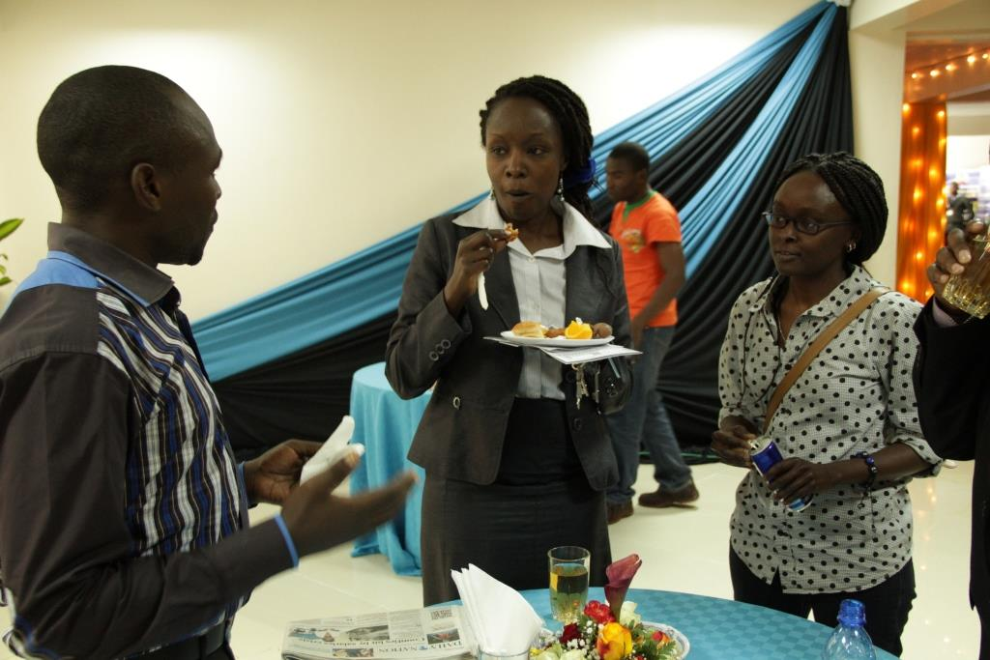
Cocktail: Incubates/ technical mentors meet-up

Slide 17
Distinguished Mentors
Dr. Manu Chandaria OBE.EBS Chairman Chandaria Foundation
Dr. S.K. Macharia, Royal Media Group
Mr. Chris Kirubi, Chairman of Haco industries Kenya
Ms. Eva Muraya- Colour Creations
Mr. Ben Maina- CEO RUPU
Mr. Ken Njoroge-CEO Cellulant
Mr. Mike Macharia-CEO Seven Seas Technologies
Ms. Nani Mungai-Britak Centre
Evelyn Mungai, OGW Evelyn College of Design

Slide 18

Selected Companies @Chandaria BIIC

Slide 19
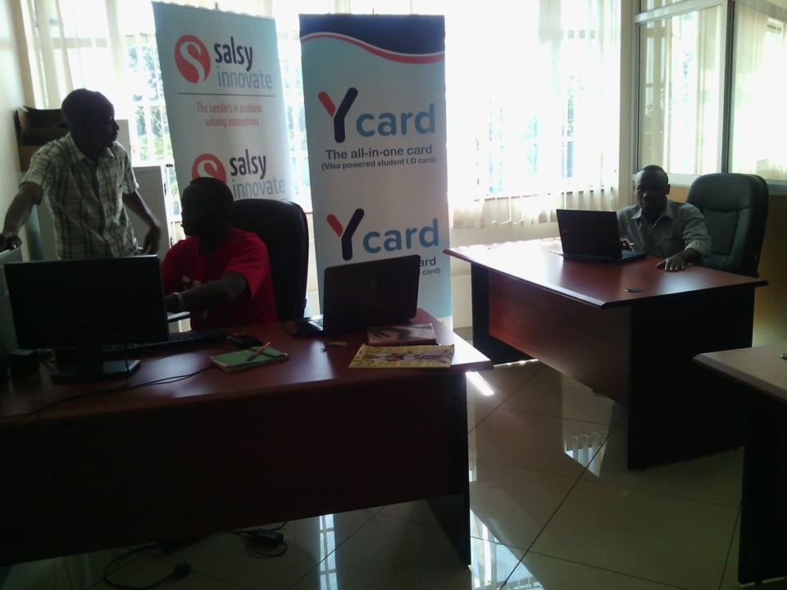

Selected Companies @Chandaria BIIC

Slide 20

Selected Companies @Chandaria BIIC
Producing interactive software to induce knowledge to the literate and literate in an entertaining way making learning fun

Slide 21
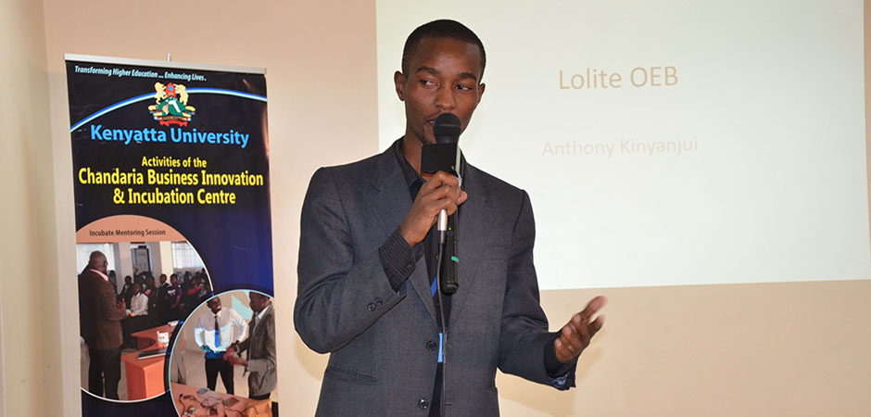
Selected Companies @Chandaria BIIC

Slide 22
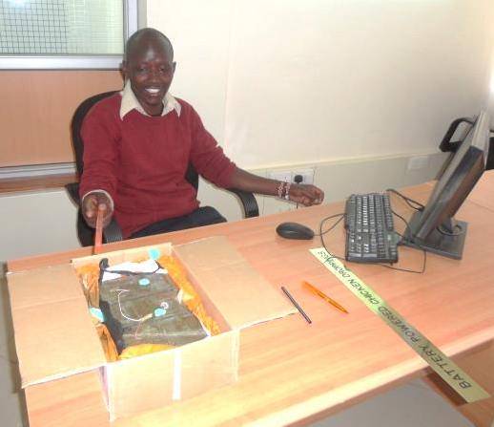
Selected Companies @Chandaria BIIC
Korio Energy produces batteries from chicken droppings
He won COMESA Innovation Awards 2013
Korio Energy Company

Slide 23
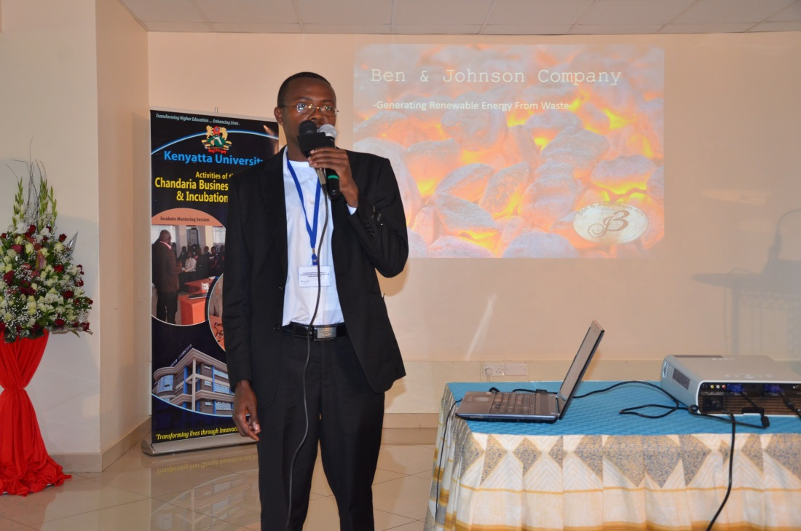

Selected Companies @Chandaria BIIC
This company produces portable biogas kits made from recycled plastic, tarpaulin
Ben and Johnson

Slide 24
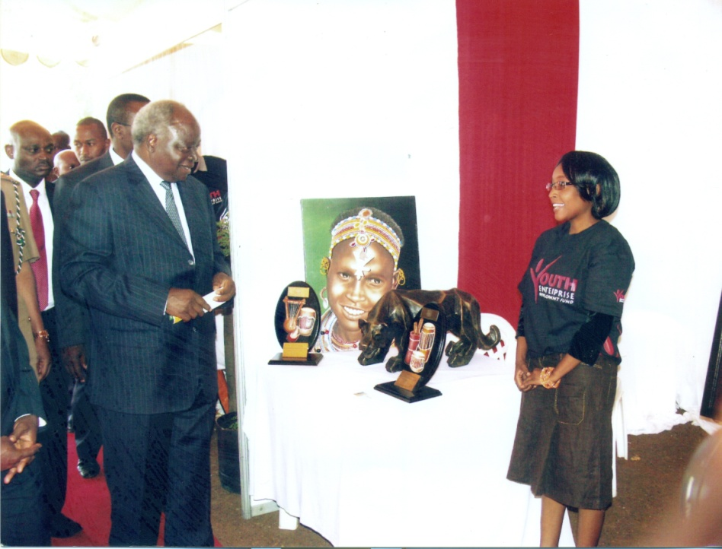
Selected Companies @Chandaria BIIC
Art Folio Company produces paintings and customized gift items
This company uses 3D technology
Visit by His Excellency former President Hon. Mwai Kibaki
Art Folio Company

Slide 25
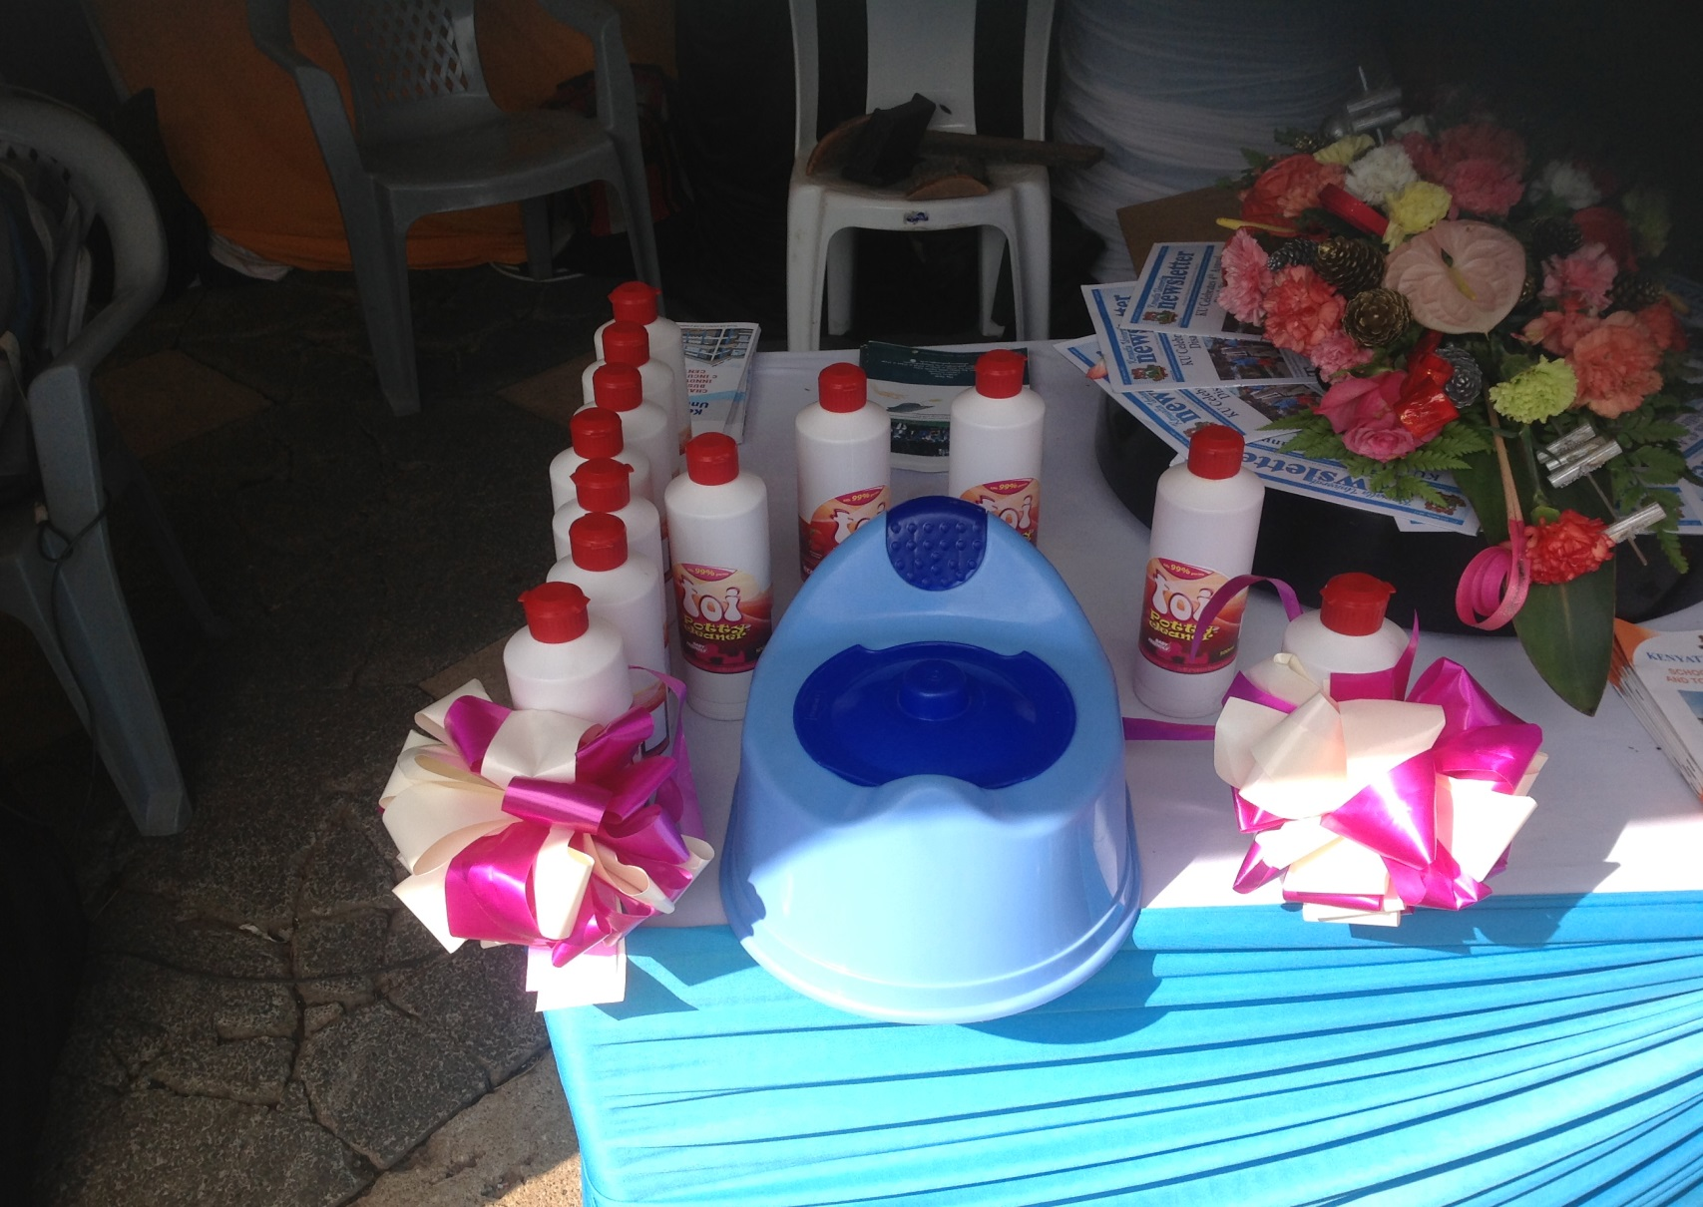
Selected Companies @Chandaria BIIC

Slide 26
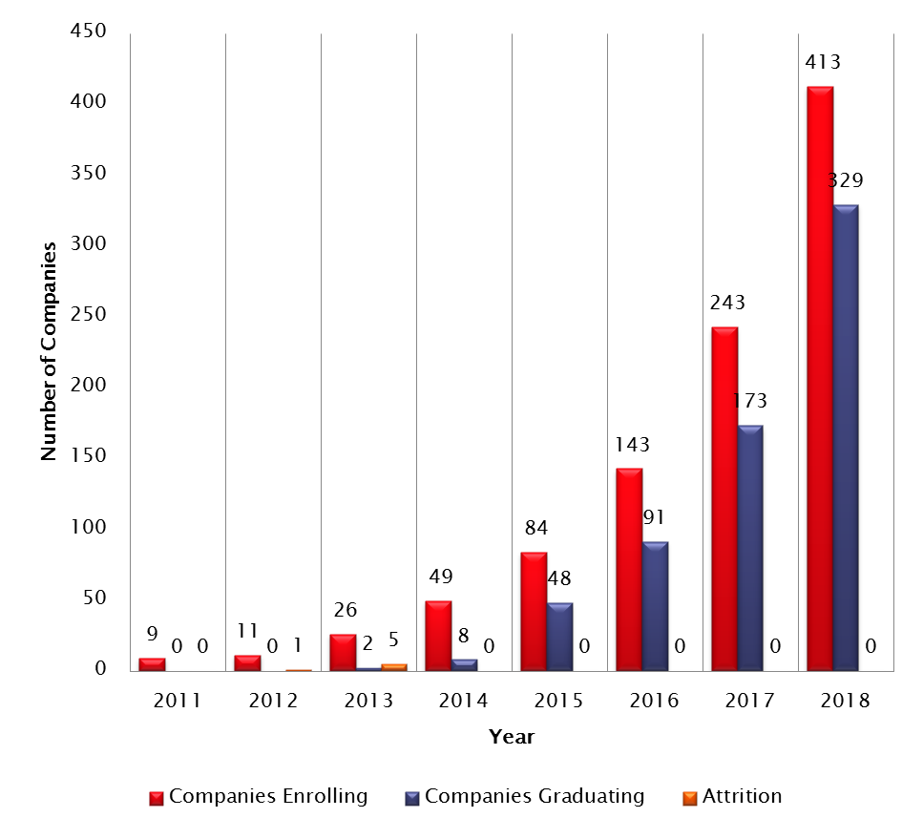
Statistics and Envisaged Growth

Slide 27
Objectives: Strategic Plan 2013-2017
Create demand for innovation and incubation services rendered at Chandaria-BIIC.
Provide highly effective innovation and incubation services in line with international best practices.
Develop an exit strategy for incubated ideas and businesses.
Strengthen and expand innovation and incubation services delivery using the virtual platform.
Build human resources capacities for effective delivery of innovation and incubation services.
Establish a collaboration framework between Chandaria-BIIC and Partners.
Establish a robust planning, research, monitoring and evaluation framework and mechanism.
Develop a sustainability framework of operations.

Slide 28

Investors Conference

Slide 29
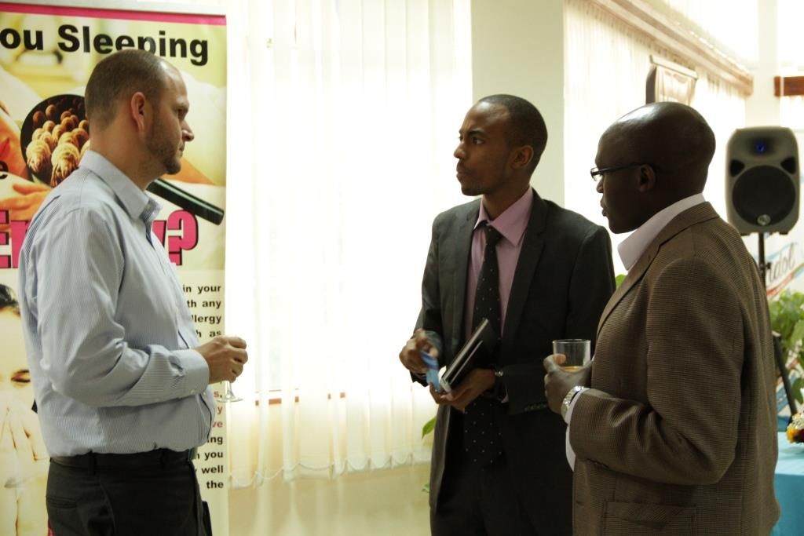
Investors Conference

Slide 30
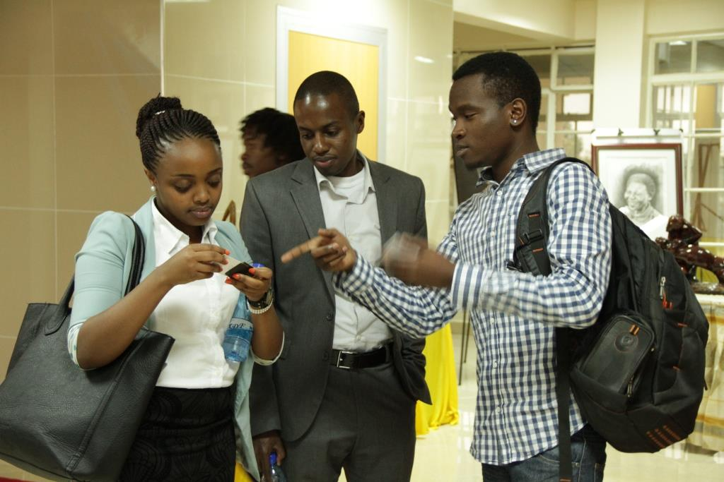
Investors Conference

Slide 31






Innovation Entrepreneurship Ecosystem

Slide 32
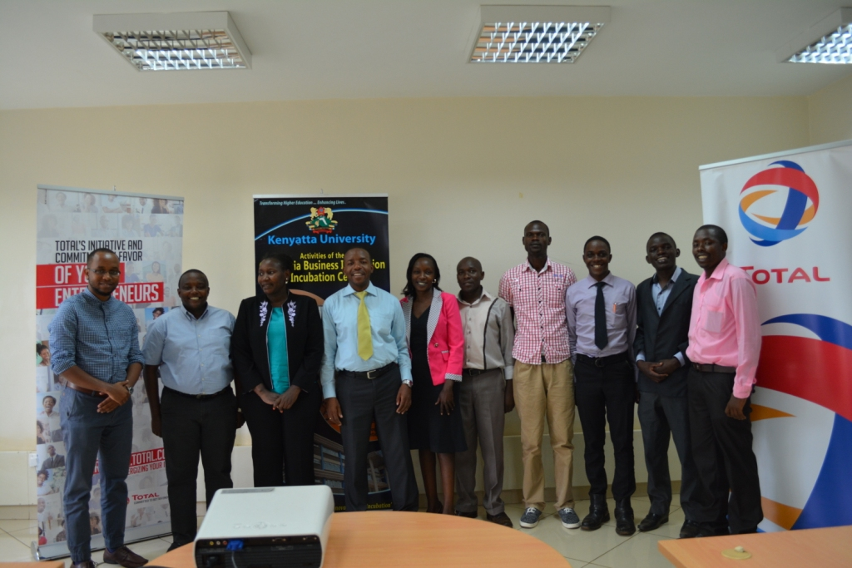


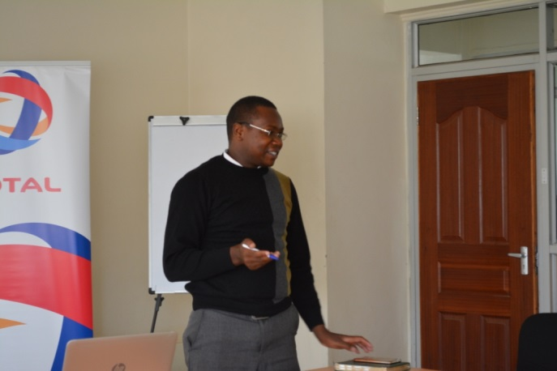
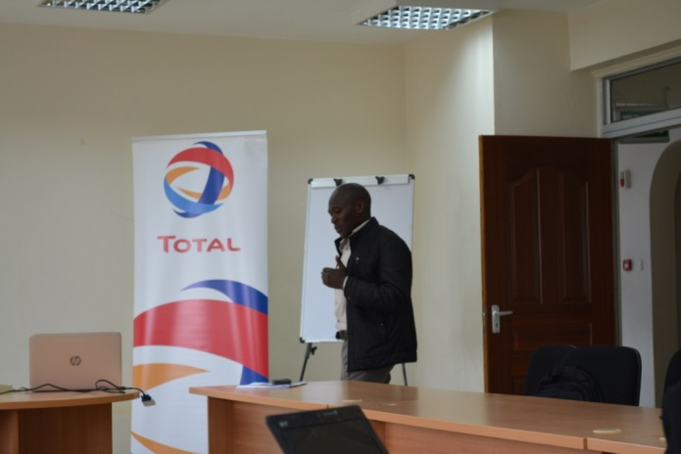
Total Startupper Challenge

Slide 33
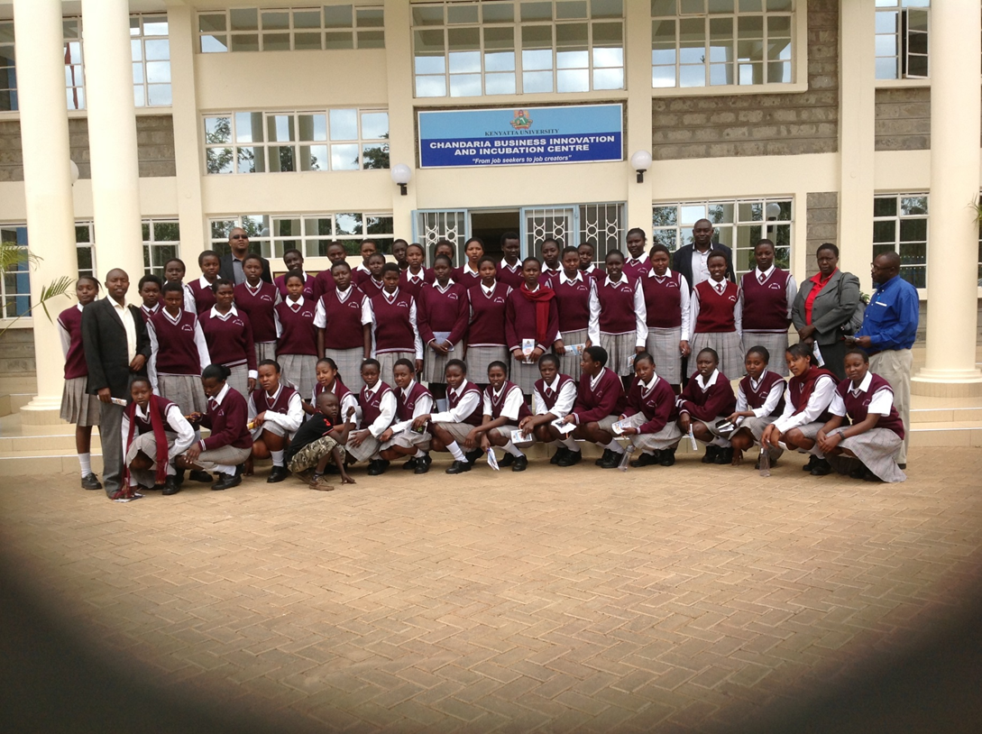
Outreach: Seko Girls High School

Slide 34
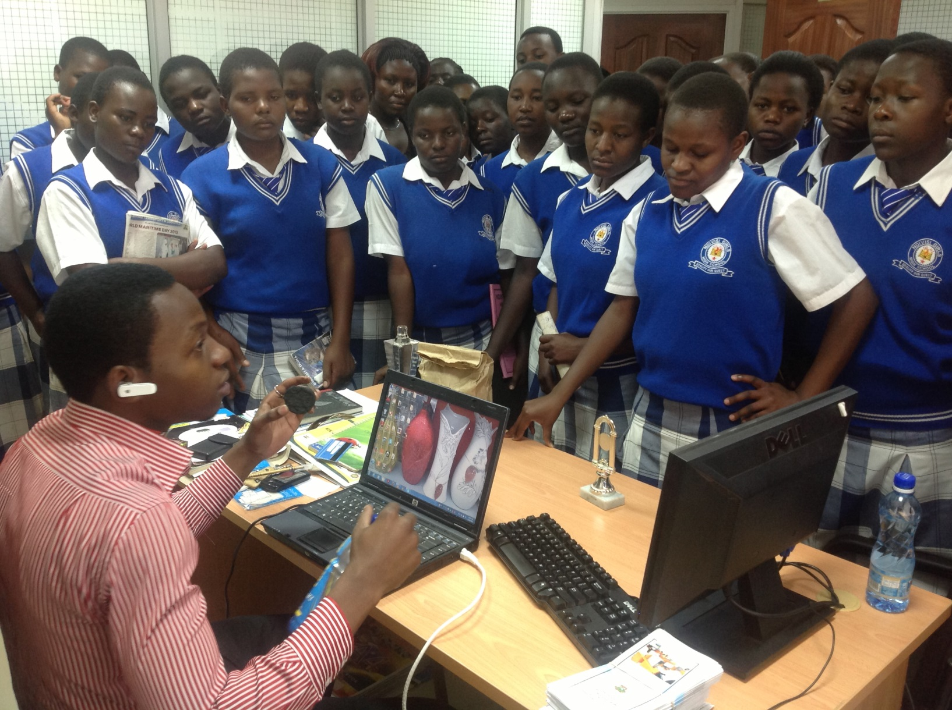
Outreach: Ndivisi Girls High School

Slide 35
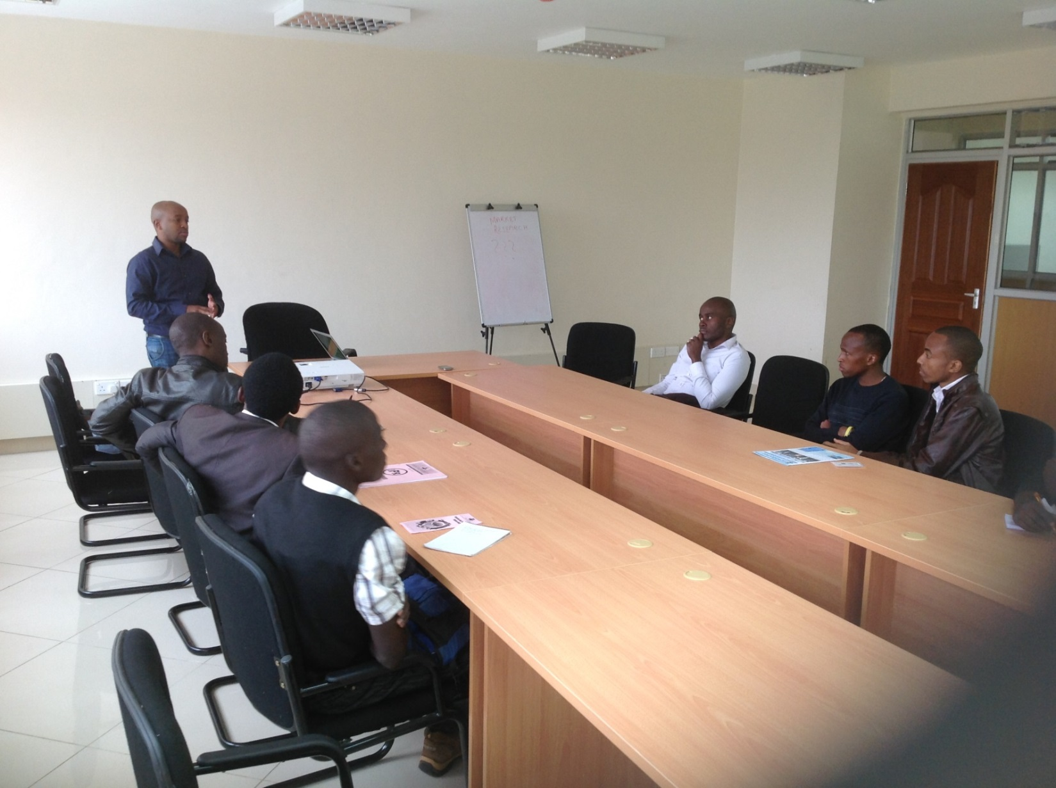
Distinguished Mentorship: Ben Maina, CEO, Rupu Ltd

Slide 36
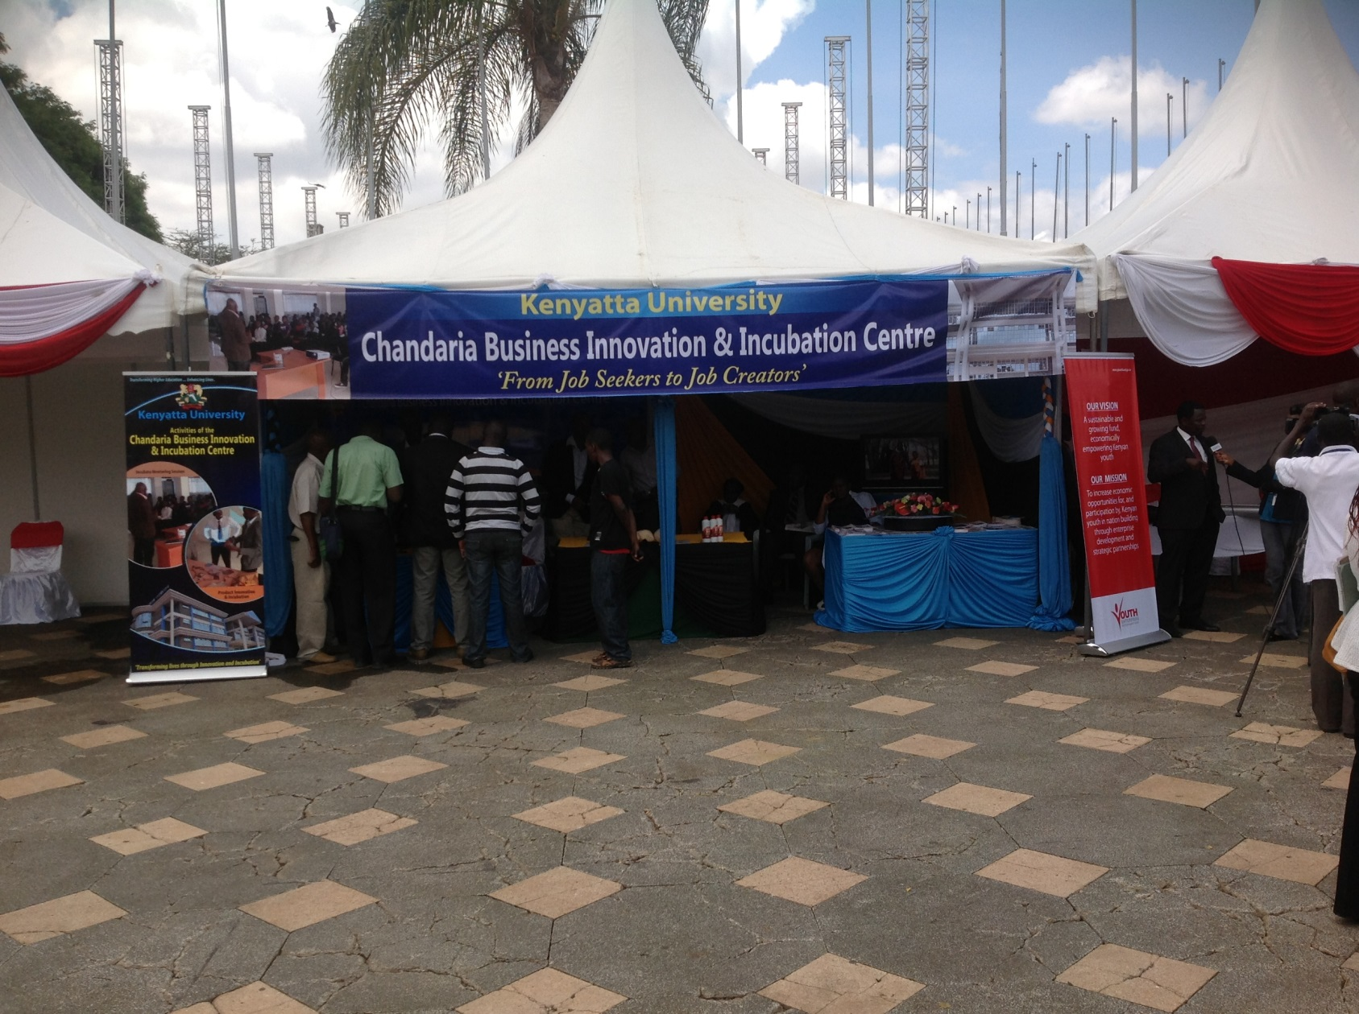
Participation: National Youth Trade Fairs

Slide 37
How Partners Can Assist
Supporting incubate(s) in a certain category
Adopting an incubate in a certain category
Financing the development of prototypes
Facilitating their travel and upkeep for travel both domestically and foreign

Slide 38










Thank Our Partners

Slide 39
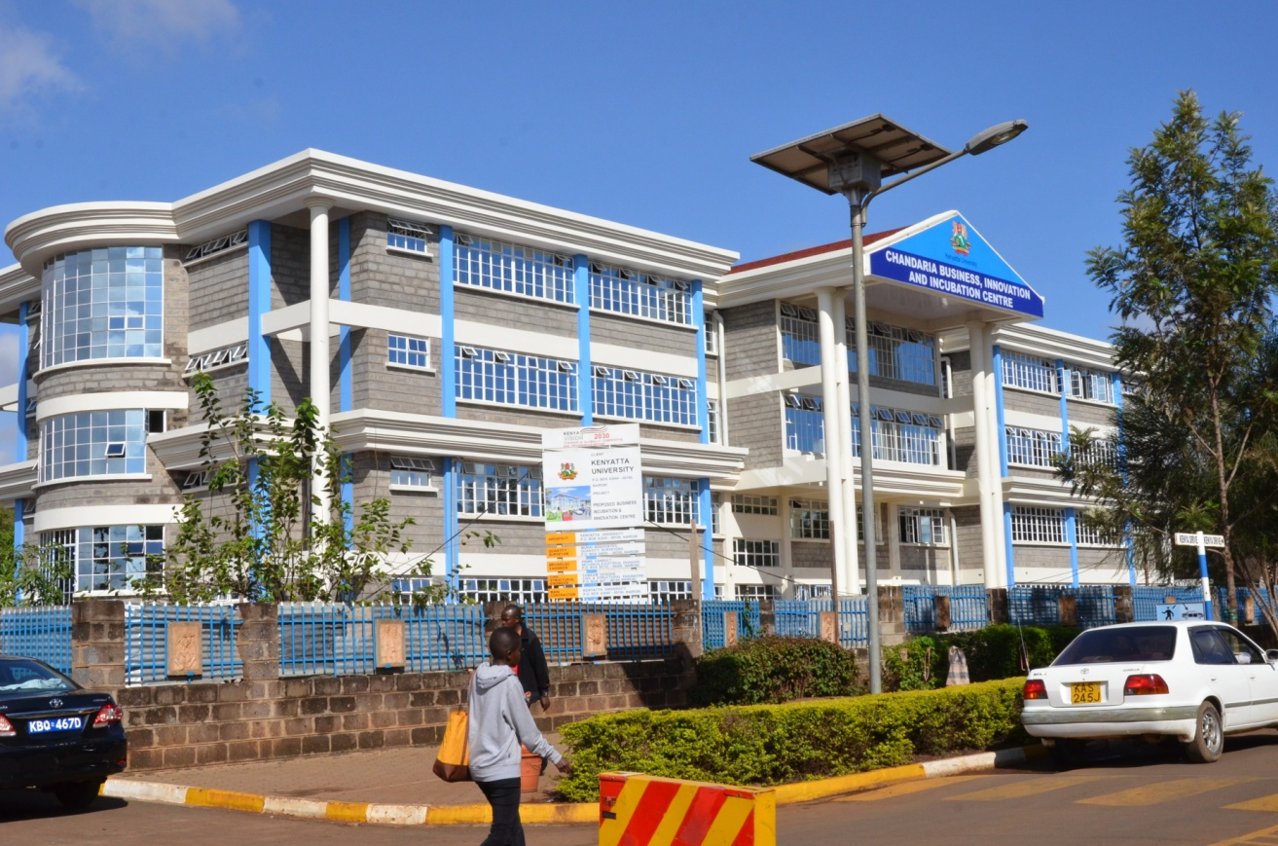
Pay us a visit……….
Contact us
Director, Chandaria-BIIC
Office: +254 020 87103651/3
Cell phone: +254 700 363 741
Email: director-cbiic@ku.ac.ke
Website: www.ku.ac.ke/c-biic/
Chandaria BIIC Building, Kenya Drive, Next to KU Main Gate

Slide 40
Thank You

